Slide 1

“TELECOM CUSTOMER CHURN PREDICTION USING SUPERVISED MACHINE LEARNING TECHNIQUES”
FINAL REVIEW
BATCH NO: C 12
SUPERVISED BY,
Mrs. E. ARCHANA, M.E.,(Ph.D.,)
Assistant Professor,
Department of CSE
TEAM MEMBERS
ANUJHA SB (211519104016)
KIRAN KOUSHIKA R (211519104070)
REEHANA S (211519104127)

Slide 2
TITLE : “TELECOM CUSTOMER CHURN PREDICTION USING SUPERVISED MACHINE LEARNING TECHNIQUES”
BASE PAPER TITLE: “CHORACLE: A UNIFIED STATISTICAL FRAMEWORK FOR CHURN PREDICTION”

Slide 3
ABSTRACT
One of the biggest issues and top concerns for big businesses is customer churn. Companies are attempting to create methods to predict possible customer churn due to the direct impact on the revenues of the companies, especially in the telecom area. In order to reduce customer churn, it is crucial to identify the variables that contribute to this churn. Our work's primary contribution is the creation of a model for predicting customer turnover that helps telecom carriers identify those clients who are most likely to experience churn. The objective of this research is to present a novel method for identifying potential customers who might leave in order to design marketing retention tactics accordingly. The historical dataset is gathered, and the machine learning model is built using that dataset.

Slide 4
INTRODUCTION
Telecom industry is constantly evolving and innovating. Due to the ever-increasing competition among the corporations, an increased importance is being given to targeted promoting methods for customer churn management. Modern day customers expect the best services at affordable rates. In case they are not satisfied, they quickly switch to another telecom network . Companies must find innovative ways to predict potential customer churn in order to prosper in such a competitive market . Customer churn is defined as the proportion of customers who stopped using a particular company’s products or services during a definite time frame.

Slide 5
EXISTING SYSTEM
User churn is a significant problem for Internet businesses that threaten their future viability and profitability. The majority of earlier studies on churn prediction reduce the issue to a binary classification challenge in which customers are classified as churned or non-churned. Recently, some studies have attempted to translate the forecast of user churn into the prediction of user return time. In this strategy, which is more accurate for real-world online services, the model forecasts the user return time at each time step rather than a churn label. The earlier studies in this field, however, lack generality and demand complicated computations. In the current study, we introduce an oracle that forecasts user churn by simulating user return rates to services using a combination of Temporal Point Processes and Recurrent Neural Networks. In addition, we add latent variables to the suggested recurrent neural network to simulate the hidden system user loyalty.
Techniques used: Recurrent neural Network
EXISITING SYSTEM DISADVANTAGES
.
Machine learning prediction methods are not being used.
Their model's precision is not being obtained.
The deployment phase is not being implemented.

Slide 6
PROPOSED SYSTEM
The proposed method involves applying machine learning to create a prediction of telecom customer churn. We intend to create an AI-based model. Data are required to train our model. Therefore, the dataset for telecom customer churn can be used to train the model. We must comprehend the training intentions to make use of this dataset. The intent is the purpose for which a user interacts with a predictive model or the purpose for which each piece of data that a certain user provides to the model is provided. These intents may differ from one another depending on the domain for which you are designing an AI solution. The aim is to create training samples for each intent, define various intents, and then train the AI model using the intents as model training categories and the training sample data as model training data. The vectorization technique, which uses the vectors to comprehend the data is used to develop the model. We can achieve a better AI model and the best accuracy by using multiple algorithms. Following model construction, the model is assessed using a variety of measures including confusion metrics, precision, recall, sensitivity, F1 score, and others.
Technique used: Supervised Machine Learning Techniques
PROPOSED SYSTEM ADVANTAGES
We are developing a predictive AI algorithm for predicting telecom customer churn.
To increase accuracy, we are implementing machine learning algorithms.
The outcome estimations can be calculated to improve performance outcomes.

Slide 7
LITERATURE SURVEY
PAPER 1: Churn Prediction in Telecommunications using Logistic Regression and Logit Boost
AUTHORS: Hemalata Jain, Ajay Khunteta, Sumit Srivastava
ABSTRACT: Today in every industry weather, it is ISP, IT products, social network or mobile services there is the problem of customer churn (Customers changing their services from one service provider to another). However, in telecommunication the customers churning very frequently. As the market in telecom is fiercely competitive, in that case, companies proactively have to determine the customers' churn by analyzing their behavior and try to put effort and money in retaining the customers. In this proposed model, two machine-learning techniques were used for predicting customer churn: Logistic regression and Logit Boost. Experiment was carried out in the WEKA Machine-learning tool, along with a real database from an American company Orange. The results were shown in different evaluation measures.
MERIT: Using Logistic Regression makes it easier to implement, interpret, and very efficient to train.
DEMERIT: Using Logistic Regression constructs linear boundaries.

Slide 8
PAPER 2: Telecom Churn Prediction System Based on Ensemble Learning Using Feature Grouping
AUTHORS: Tianpei Xu, Ying Ma and Kangchul Kim
ABSTRACT: In recent years, the telecom market has been very competitive. The cost of retaining existing telecom customers is lower than attracting new customers. It is necessary for a telecom company to understand customer churn through customer relationship management (CRM). Therefore, CRM analyzers are required to predict which customers will churn. This study proposes a customer-churn prediction system that uses an ensemble-learning technique consisting of stacking models and soft voting. Xgboost, Logistic regression, Decision tree, and Naïve Bayes machine-learning algorithms are selected to build a stacking model with two levels, and the three outputs of the second level are used for soft voting. Feature construction of the churn dataset includes equidistant grouping of customer behavior features to expand the space of features and discover latent information from the churn dataset. The original and new churn datasets are analyzed in the stacking ensemble model with four evaluation metrics. The experimental results show that the proposed customer churn predictions have accuracies of 96.12% and 98.09% for the original and new churn datasets, respectively. These results are better than state-of-the-art churn recognition systems.
MERIT: When the dataset consists of both linear and non-linear data, Ensemble methods are very useful.
DEMERIT: This method is less interpretable and it is hard to predict and explain the output of the ensembled model.

Slide 9
PAPER 3: Churn prediction in telecommunication industry using kernel Support Vector Machines
AUTHORS: Nguyen Nhu Y, Tran Van Ly, Dao Vu Truong Son
ABSTRACT: In this age of fierce competitions, customer retention is one of the most important tasks for many companies. Many previous works proposed models to predict customer churn based on various machine learning techniques. In this study, we proposed an advanced churn prediction model using kernel Support Vector Machines (SVM) algorithm for a telecom company. Baseline SVM models were initially built to find out the most suitable kernel types and will be used to make comparison with other approaches. Dimension reduction strategies such as Sequential Forward Selection (SFS) and Sequential Backward Selection (SBS) were applied to the dataset to find out the most important features. Furthermore, resampling techniques to deal with imbalanced data such as Synthetic Minority Oversampling Technique Tomek Link (SMOTE Tomek) and Synthetic Minority Oversampling Technique ENN (SMOTE ENN) were used on the dataset. Using the above-mentioned techniques, we have obtained better results compared to those obtained from previous works, we achieved an F1-score and accuracy of 99% and 98.9% respectively.
MERIT: When there is a clear margin of separation between classes, this algorithm works relatively well.
DEMERIT: This algorithm underperforms when the number of features for each data point exceeds the number of training data samples.

Slide 10
PAPER 4: Telecom Customer Churn Prediction
AUTHORS: Abhijith Sundararajan, Kemal Gursoy
ABSTRACT: Customer churn is often referred to as customer attrition, or customer defection which is the rate at which the customers are lost. Telecom companies often use customer churn as a key business metrics to predict the number of customers that will leave a telecom service provider. Churn is significant in the telecommunication industry because it directly affects the competitiveness of the service provider. Churn is the proportion of clients leaving the service provider. The service provider should therefore find new clients to preserve profitability. This is not possible due to the high and difficult cost of acquiring new customers. The cost of retaining an existing customer is far less than acquiring a new one, so telephone service companies, Internet service providers, pay TV companies, insurance firms and alarm monitoring services use the customer churn to predict profitability. Businesses basically believe that a customer has churned with the amount that has passed since the customer’s last interaction with the site or service. The full cost of customer churn includes both lost revenue and the marketing costs involved with replacing those customers with new ones. Reducing customer churn is important because cost of acquiring a new customer is higher than retaining an existing one. This case is related to telecom industry where organizations want to know that for given certain parameters whether a person will churn or not.
MERIT: The Random Forest Algorithm used here solves both classification as well as regression problems and also works well with both categorical and continuous variables.
DEMERIT: The computations of this algorithm goes far more complex compared to other algorithms and this algorithm changes considerably even when there exists a small change in the data.

Slide 11
PAPER 5: Telecom Churn Prediction Using an Ensemble Approach with Feature Engineering and Importance
AUTHORS: Hemlata Jain a, Ajay Khunteta, Sumit Srivastava
ABSTRACT: In Telecommunication industry, churn prediction is loss of customers and faces fierce competition to retain customers. Churn is the phenomena of a customer leaving a business, and in this context, churn prediction refers to predicting the client's intention to leave. In order to retain customers company needs a good churn prediction model. For a churn prediction model, company needs to predict why customer have churned in past and which factor is most important to predict customers who are near churn. This paper primarily focused on the feature importance and feature engineering for churn prediction model. For classification phase two ensemble models, Random forest and Gradient boosted trees were used. This paper also emphasised on why feature importance and feature engineering are important prediction. where, this paper includes various data pre-processing steps that played an important role in this model. This model uses Cell2Cell dataset of size 3333 subscribers and 57 features. This study presented a very good comparison between the model developed in the study with old models. The implementation part has been done using python and apache spark, that are very good platform for data analysis using machine learning and data mining. For improved performance and effective outcomes Hyper parameter optimization using a grid is used. Prediction performance is evaluated for accuracy, Confusion matrix before and after grid based hyper parameter optimisation. The model out performed and achieved 95% accuracy using Random Forest and 97% accuracy using gradient boosted trees.
MERIT: This algorithm allows for more accurate estimations or predictions and makes it easier to maintain less complex models.
DEMERIT: Using this algorithm consumes time and solutions achieved through this algorithm are difficult to explain because of the unclear model’s logic.

Slide 12
SYSTEM SPECIFICATIONS
HARDWARE SPECIFICATION:
Processor : Pentium IV/III
Hard disk : minimum 80 GB
RAM : minimum 2GB
SOFTWARE SPECIFICATION:
Operating System : Windows
Simulation Tool : Anaconda with Jupyter Notebook

Slide 13
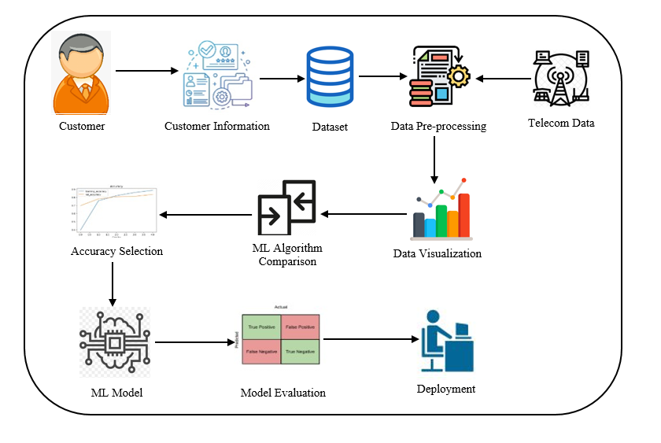
SYSTEM ARCHITECTURE

Slide 14
MODULES
Data Pre-processing
Data Analysis of Visualization
Implementing Support Vector Machine
Implementing Logistic Regression
Implementing Random Forest Classifier
Implementing Decision Tree Classifier
Comparing Algorithm with prediction in the form of best accuracy result
Deployment Using Django Framework

Slide 15
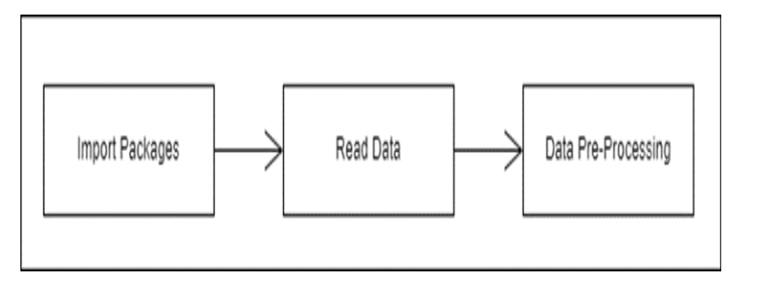
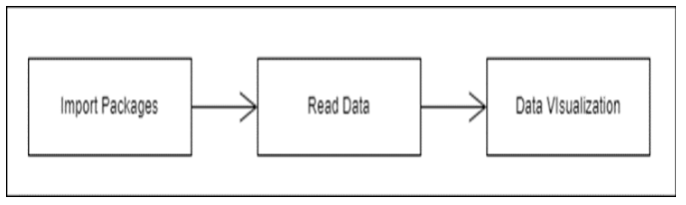
MODULE DESCRIPTION
Data Pre-processing The data which was collected might contain missing values that may lead to inconsistency. To gain better results data need to be preprocessed so as to improve the efficiency of the algorithm. The outliers have to be removed and also variable conversion need to be done.However, working with data samples that could not be a realistic reflection of the population of a given dataset in real-world circumstances. Finding duplicate values, missing values, and information about the data type—whether a float variable or an integer—are all necessary. the subset of data used to assess a model's fit to a training dataset while adjusting model hyperparameters.
Data Analysis of Visualization
Importing the library packages with loading given dataset. To analyzing the variable identification by data shape, data type and evaluating the missing values, duplicate values. A validation dataset is a sample of data held back from training your model that is used to give an estimate of model skill while tuning model's and procedures that you can use to make the best use of validation and test datasets when evaluating your models. Data cleaning / preparing by rename the given dataset and drop the column etc. to analyze the uni-variate, bi-variate and multi-variate process. The steps and techniques for data cleaning will vary from dataset to dataset. The primary goal of data cleaning is to detect and remove errors and anomalies to increase the value of data in analytics and decision making.

Slide 16
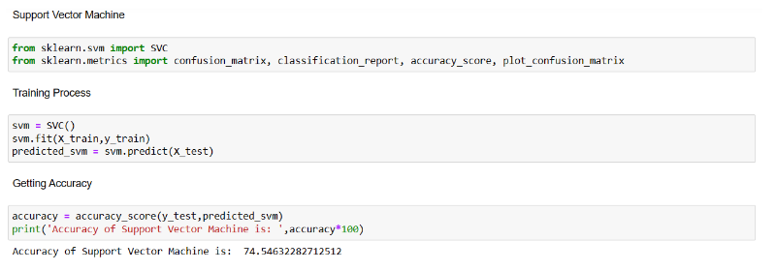
Implementing Support Vector Machine
The SVM algorithm's objective is to establish the best line or decision boundary that can divide n-dimensional space into classes, allowing us to quickly classify fresh data points in the future. A hyperplane is the name given to this optimal decision boundary.
SVM selects the extreme vectors and points that aid in the creation of the hyperplane. Support vectors, which are used to represent these extreme instances, form the basis for the SVM method.
Fig 1. Implementing Support Vector Machine

Slide 17
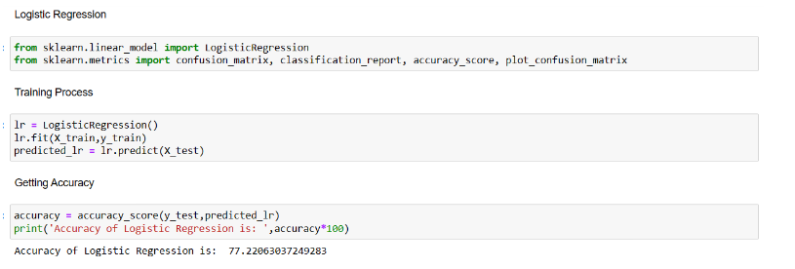
Implementing Logistic Regression
A dichotomous variable (one with only two possible outcomes) is used to measure the result. Finding the best-fitting model to explain the link between a set of independent (predictor or explanatory) factors and a dichotomous feature of interest (dependent variable = response or outcome variable) is the aim of logistic regression. The likelihood of a categorical dependent variable is predicted using the Machine Learning classification algorithm known as logistic regression. The dependent variable in logistic regression is a binary variable with data coded as 1 (yes, success, etc.) or 0.
Fig 2. Implementing Logistic Regression

Slide 18
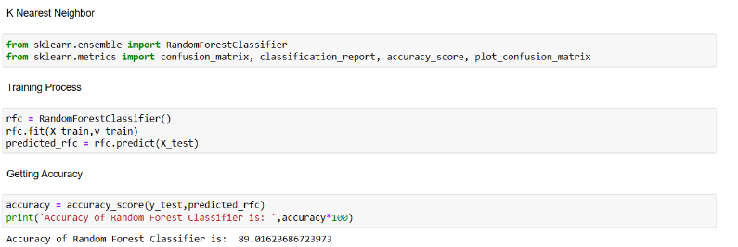
Implementing Random Forest Classifier
As an ensemble learning technique for classification, regression, and other tasks, random forests or random decision forests build a large number of decision trees during the training phase and output the class that represents the mean of the classes (classification) or mean prediction (regression) of the individual trees. The tendency of decision trees to overfit their training set is corrected by random decision forests. A supervised machine learning approach based on ensemble learning is known as random forest. In order to create a more effective prediction model, you can combine several kinds of algorithms or use the same technique more than once in ensemble learning.
Fig 3. Implementing Random Forest Classifier

Slide 19
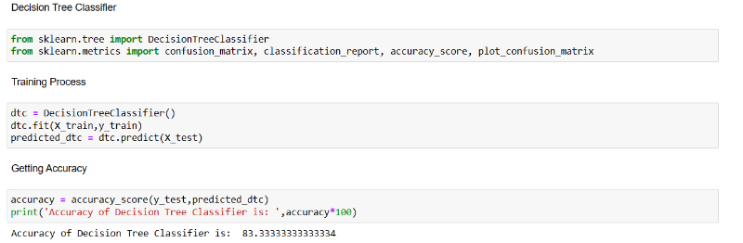
Implementing Decision Tree Classifier
A decision tree uses a tree structure to develop classification or regression models. It incrementally develops an associated decision tree while segmenting a data set into smaller and smaller parts. A decision node is represented by a leaf node, which has two or more branches and denotes a categorization or judgement. The root node is the topmost decision node in a tree and corresponds to the best predictor. Both category and numerical data can be processed using decision trees. A decision tree uses a tree structure to develop classification or regression models. It employs a collection of if-then rules that are exhaustive and mutually exclusive for classification. The rules are learned one at a time utilising the training data in a systematic manner. The tuples that the rules cover are eliminated each time a rule is learned.
Fig 4. Implementing Decision Tree Classifier

Slide 20
Comparing Algorithm with prediction in the form of best accuracy result
In this paper, we have compared several algorithms that can predict whether the customer will terminate the service . The comparison of several classifiers will help us to accurately predict customer churn as well as addressing the main factor that leads to customer retention. We are analyzing all the classifiers in several aspects. Based on the results and evaluation, we observed that the Random forest Algorithm outperforms the others with the accuracy of 89.01%.

Slide 21
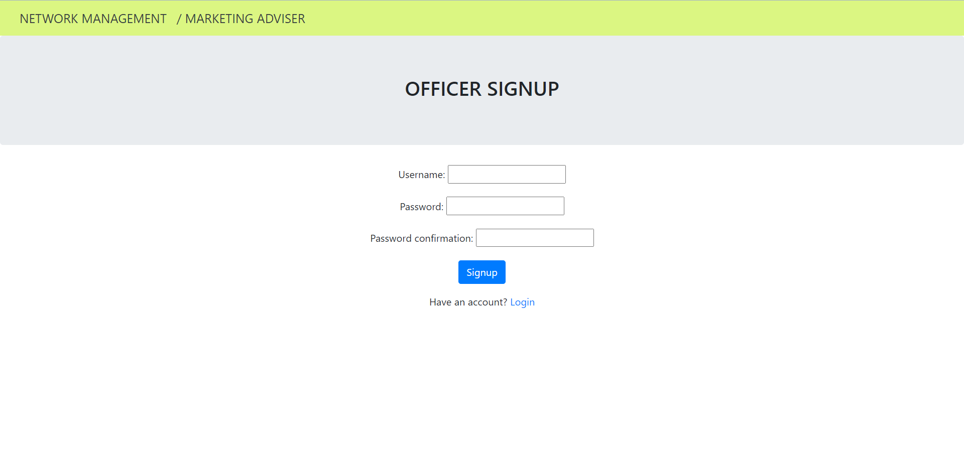
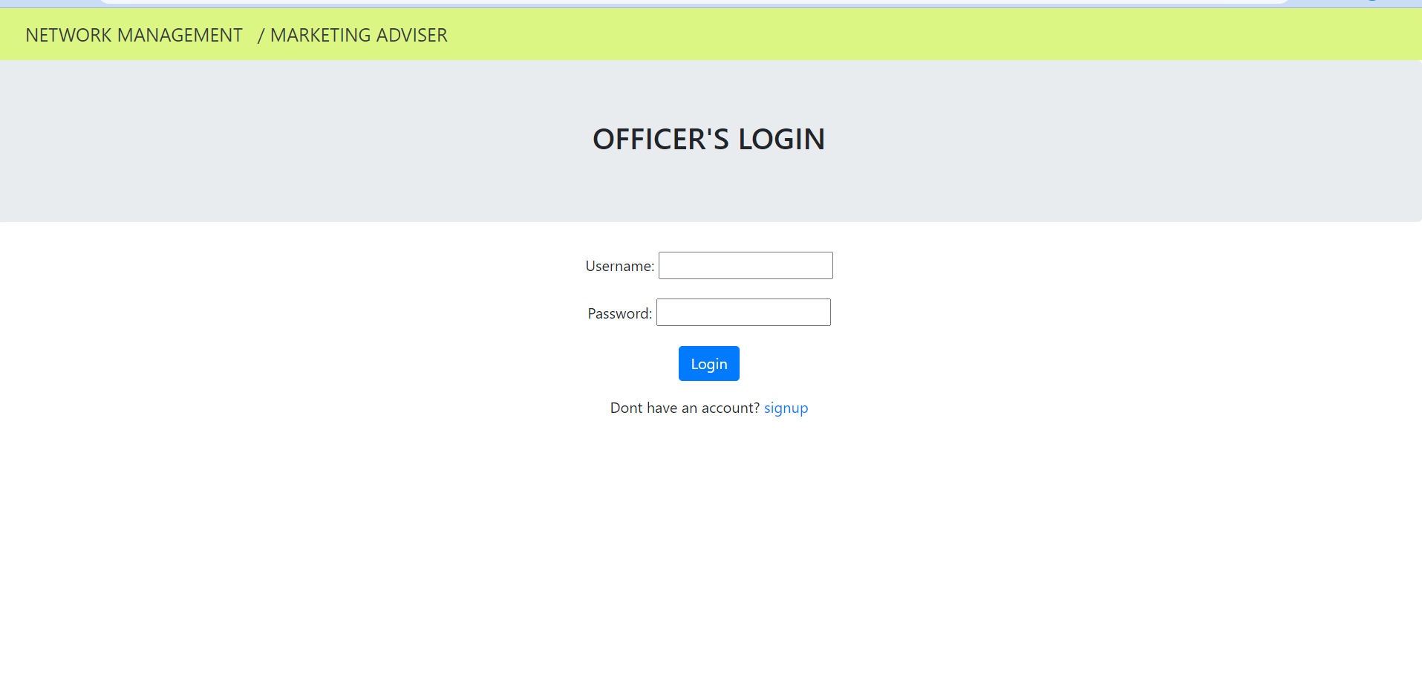
Deployment Using Django Framework
Fig 5. Signup Page
Fig 6. Login Page

Slide 22
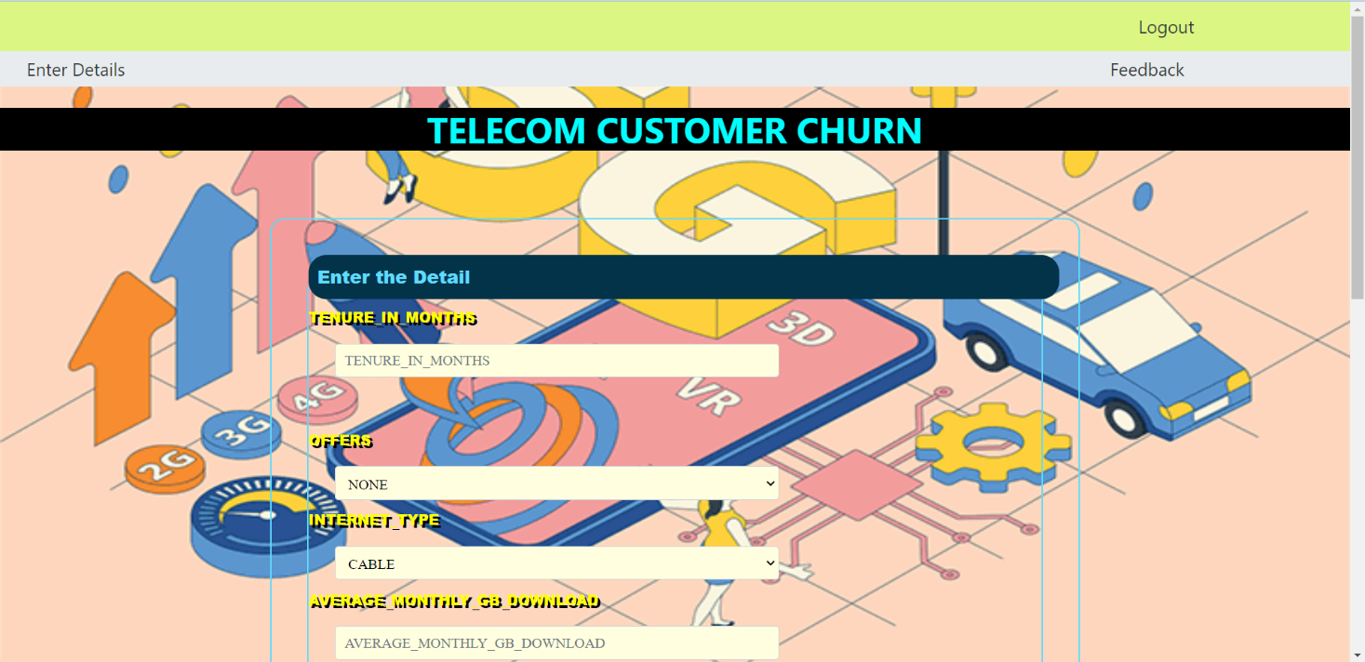
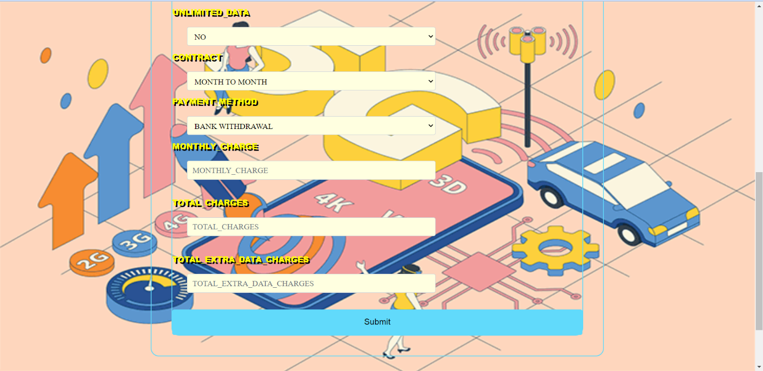
Fig 7. Enter Details Page 1
Fig 8. Enter Details Page 2

Slide 23
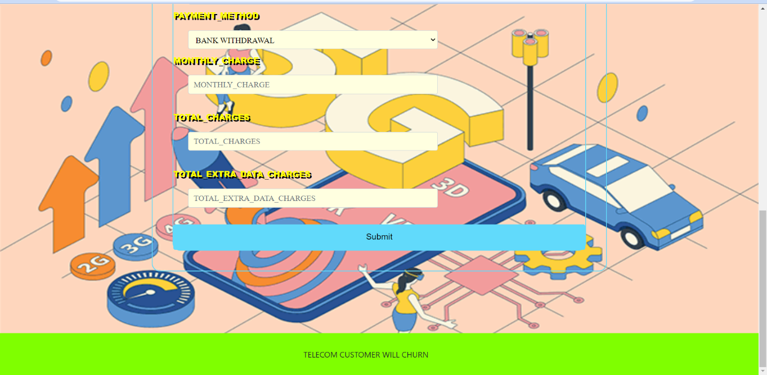
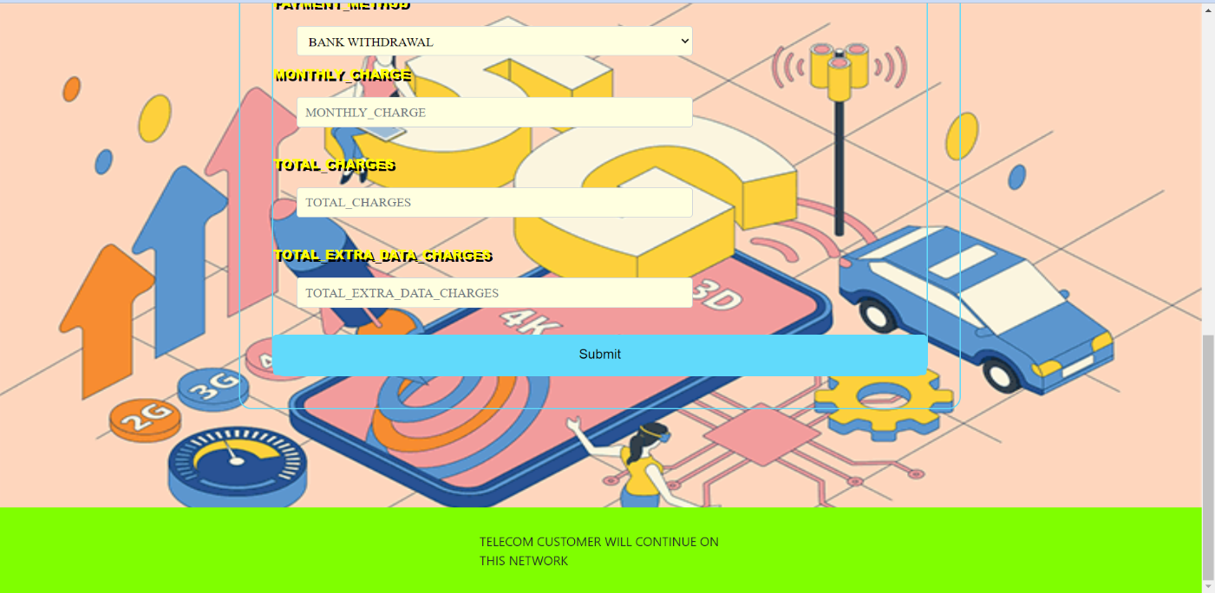
Fig 9. Output Screenshot 1
Fig 10. Output Screenshot 2

Slide 24
CONCLUSION
The analytical process started from data cleaning and processing, missing values analysis, exploratory analysis and finally model building and evaluation. The best accuracy on public test set is higher accuracy score will be find out. This project can help to find the Prediction of Telecom Customers Churn Details.
FUTURE ENHANCEMENT
Feature engineering: Reviewing the features that are currently using in this model and adding new features that might be relevant to this prediction task. Incorporating customer demographic data or information about their past interactions with the company.
Model tuning: Experiment with different algorithms and hyperparameters to find the best performing model
Implementing an online learning system which allows the model to continuously learn from new data as it becomes available.
Integration: Integrating the model into other systems and processes within the organization. For example, we might use the predictions to inform marketing campaigns or prioritize customer support tickets.
By continuously refining and improving the model, we can ensure that it remains relevant and effective for business needs.

Slide 25
REFERENCES
[1] Jain, H., Khunteta, A. and Srivastava, S., 2020. Churn prediction in telecommunication using logistic regression and logit boost. Procedia Computer Science, 167, pp.101-112.
[2] Xu, T., Ma, Y. and Kim, K., 2021. Telecom churn prediction system based on ensemble learning using feature grouping. Applied Sciences, 11(11), p.4742.v
[3] Ly, T.V. and Son, D.V.T., 2022. Churn prediction in telecommunication industry using kernel Support Vector Machines. Plos one, 17(5), p.e0267935.
[4] Sundararajan, A. and Gursoy, K., 2020. Telecom customer churn prediction.
[5] Jain, H., Khunteta, A. and Srivastava, S., 2022. Telecom Churn Prediction Using an Ensemble Approach with Feature Engineering and Importance. International Journal of Intelligent Systems and Applications in Engineering, 10(3), pp.22-33.
[6] Melian, D.M., Dumitrache, A., Stancu, S. and Nastu, A., 2022. Customer Churn Prediction in Telecommunication Industry. A Data Analysis Techniques Approach. Postmodern Openings, 13(1 Sup1), pp.78-104.
[7] Peng, K. and Peng, Y., 2022. Research on Telecom Customer Churn Prediction Based on GA-XGBoost and SHAP. Journal of Computer and Communications, 10(11), pp.107-120.
[8] Sudharsan, R. and Ganesh, E.N., 2022. A Swish RNN based customer churn prediction for the telecom industry with a novel feature selection strategy. Connection Science, 34(1), pp.1855-1876.
[9] Ali, M., Rehman, A.U., Hafeez, S. and Ashraf, M.U., 2018, August. Prediction of churning behavior of customers in telecom sector using supervised learning techniques. In 2018 International Conference on Computer, Control, Electrical, and Electronics Engineering (ICCCEEE) (pp. 1-6). IEEE.
[10] Ullah, I., Raza, B., Malik, A.K., Imran, M., Islam, S.U. and Kim, S.W., 2019. A churn prediction model using random forest: analysis of machine learning techniques for churn prediction and factor identification in telecom sector. IEEE access, 7, pp.60134-60149.

Slide 26
[11] Bhanuprakash, P. and Nagaraja, G.S., 2017, December. A review on churn prediction modeling in telecom environment. In 2017 2nd International Conference on Computational Systems and Information Technology for Sustainable Solution (CSITSS) (pp. 1-5). IEEE.
[12] Shrestha, S.M. and Shakya, A., 2022. A Customer Churn Prediction Model using XGBoost for the Telecommunication Industry in Nepal. Procedia Computer Science, 215, pp.652-661.
[13] Wu, S., Yau, W.C., Ong, T.S. and Chong, S.C., 2021. Integrated churn prediction and customer segmentation framework for telco business. IEEE Access, 9, pp.62118-62136.
[14] Abdulsalam, S.O., Ajao, J.F., Balogun, B.F. and Arowolo, M.O., 2022. A Churn Prediction System for Telecommunication Company Using Random Forest and Convolution Neural Network Algorithms. EAI Endorsed Transactions on Mobile Communications and Applications, 7(21).
[15] Huang, B., Kechadi, M.T. and Buckley, B., 2012. Customer churn prediction in telecommunications. Expert Systems with Applications, 39(1), pp.1414-1425.

Slide 27
THANK YOU !

